Slide 1
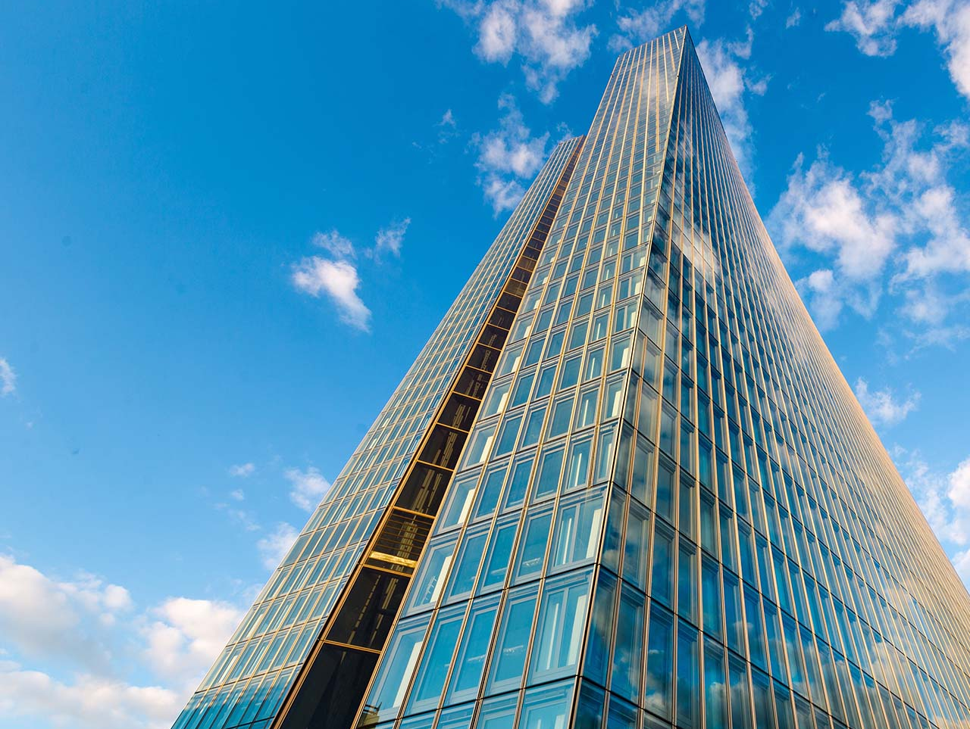
The macroeconomic effects of the climate insurance protection gap
ECB-RESTRICTED
2023 RiskLab/BoF/ESRB Conference on Systemic Risk Analytics
8 June 2023
Margherita Giuzio, European Central Bank
Linda Fache Rousová, Sujit Kapadia, Miles Parker (ECB)
Hradayesh Kumar, Luisa Mazzotta, Dimitris Zafeiris (EIOPA)
Notes:
The views expressed in this presentation are those of the authors and do not necessarily reflect those of EIOPA, the European Central Bank or the Eurosystem.

Slide 2
Natural hazards, but man-made disasters
Full impact depends not just on natural trigger, but also on exposure and vulnerability
Projecting impact of climate change means considering not just the hazard, but other factors of mitigation and exacerbation
Number of relevant natural loss events worldwide
(1985-2018; left-hand scale: number of events; right-hand scale: percentages)
Global insured catastrophe losses
(1985-2021; left-hand scale: USD billions; right-hand scale: percentages)
Sources: Swiss Re Institute, Munich Re NatCatService and ECB calculations.
Notes:
Each year across the world, natural disasters destroy assets running into multiple billions. Often, only a tiny proportion of this damage is insured. This insurance gap is considerable especially in developing and emerging countries, but with climate change, the gap is expected to widen also in developed economies. And it is often the case that either individuals and companies have to bear the costs of catastrophes OR governments have to intervene.
The Full impact of a disaster depends not just on natural trigger, but also on the exposure and vulnerability. And Vulnerability is the area we will mostly focus on today, in particular how insurance can support the recovery process and reduce the vulnerability of the economy to these shocks.
This slide shows that
The number of weather-related loss events is increasing due to climate change, as well as the insured losses.

Slide 3
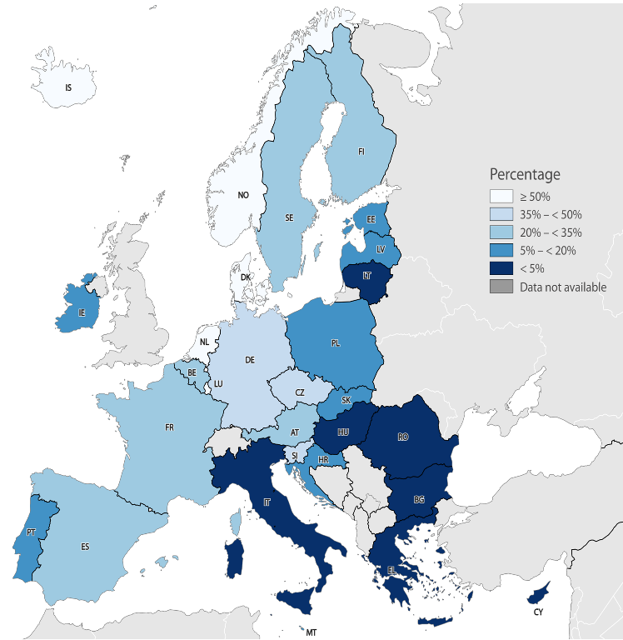
The role of insurance
Insurance is an important source of resilience
Insurance appears to help speed up reconstruction
Macro and micro evidence on the benefits of insurance (Von Peter et al., 2012; Poontirakul and Noy, 2017)
Already a substantial protection gap
Only 1/4 of climate-related catastrophe losses are insured in Europe
This insurance protection gap could widen as a result of climate change
Average share of insured economic losses caused by weather-related events in Europe
Source: EIOPA dashboard on insurance protection gap for natural catastrophes, European Environment Agency CATDAT.
Notes:
The literature points to a substantial role for external financial support for activity and reconstruction – be it from international aid or domestic fiscal transfers – in reducing the overall impact of catastrophes (McDermott et al., 2014).
This is also why insurance can play a protective role. Insurance payouts can help households and businesses better endure the post-catastrophe disruption and underpin the reconstruction phase. Von Peter et al. (2012) find that the recovery from catastrophes is faster and more complete when the share of damages covered by insurance is higher. Indeed, aggregate GDP losses appear related to the uninsured component of damages rather than to the total amount. And firm-level evidence also demonstrates the protective value of insurance (Poontirakul and Noy, 2017).
BUT only one third of catastrophe losses in Europe are insured, and this share is as low as 12% in southern European countries, giving rise to an insurance protection gap
Another aspect of the climate insurance protection gap is the increasing cost of catastrophe insurance. The property premiums in Europe are rising, which means that, although insurers are still willing to cover some losses, the affordability of this coverage is decreasing.

Slide 4
Contribution
1. Theoretical model
Demonstrates short-term protective benefit of insurance
2. Empirical analysis
Provides evidence of how insurance has helped mitigate impact of past disasters
3. Scenarios of future impact of disasters
Estimates the impact of warming coincide and wider protection gap on GDP
4. Policy discussion
Provides policy options to reduce the climate insurance protection gap

Slide 5
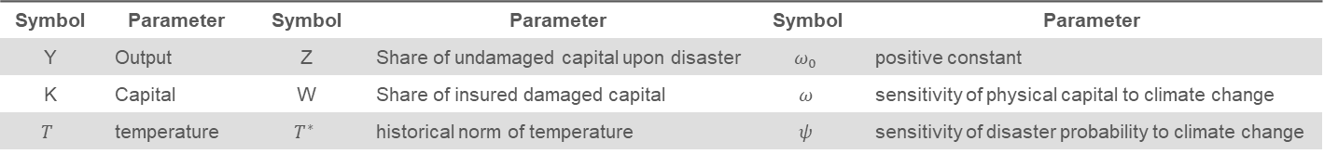
ECB-RESTRICTED
1. Modelling output in the face of natural disasters and climate change
We model output as a function of capital, temperatures and natural disasters
Capital is sensitive to long-run changes in temperatures and to intermittent but highly destructive natural disasters
Damages upon a disaster can be mitigated by insurance, which is also sensitive to changes in temperatures
$$Y=Kω_{0}e^{−ω\left(T−T^{∗}\right)}[1−\left(1−We^{−ψ\left(T−T^{∗}\right)}\right)\left(1−Z\right)]$$
Symbol | Parameter | Symbol | Parameter | Symbol | Parameter
Y | Output | Z | Share of undamaged capital upon disaster | $$ω_{0}$$ | positive constant
K | Capital | W | Share of insured damaged capital | $$ω$$ | sensitivity of physical capital to climate change
$$T$$ | temperature | $$T^{∗}$$ | historical norm of temperature | $$ψ$$ | sensitivity of disaster probability to climate change
Notes:
Let me start describing the features of our model. First, we model output as a function of capital, temperatures and natural disasters. For simplicity, we abstract from labour. Capital is sensitive to long-run changes in temperatures and to intermittent but highly destructive natural disasters. And damages upon a disaster can be mitigated by insurance, which is also sensitive to changes in temperatures.

Slide 6

1. Modelling output in the face of natural disasters and climate change
Impact of natural disasters on capital
When disasters hit, output is reduced by the uninsured share of damaged capital, the protection gap
The probability of disasters is fixed.
Our findings
Insurance can help mitigate the macro-financial and welfare impact of catastrophes
Climate change is likely to have an increasingly negative impact on welfare
Impact is likely to be magnified by a reduction in insurance coverage
$$Y=K−\left(1−W\right)\left(1−Z\right)K$$
Notes:
First, disasters are costly and influence output through their increasing frequency. Insurance can help mitigate the impact of disasters by relaxing financial constraints and accelerating the rebuild, thereby reducing the overall welfare loss.
In the first step, we map changes in capital to three variables: the total amount of capital in the absence of disasters K, the amount of damaged capital upon a disaster (1-Z)K and the insurance payout WK.
[Disasters occur as discrete downward jumps to the capital stock and can be modelled as Poisson arrivals with a mean arrival rate $π$, which is fixed, in the absence of climate change.]
Output growth is constrained following a disaster because both the available capital stock decreases, and because resources are reallocated away from the optimum.
The payouts from insurers reduce uncertainty and support aggregate demand and investment for reconstruction, which helps to accelerate the recovery from a natural disaster.
We show in the paper that the duration of the reconstruction phase determines the macroeconomic cost of natural disasters. If damages can be repaired immediately, output losses will be zero, but consumption will be reduced to reconstruct (i.e. C = K). By contrast, if there is no reconstruction, output losses will be permanent (R = infinite) and will be absorbed by consumption.
[In this model, lost capital has a productivity equal to the average productivity of the capital in the economy.]
[Although reconstruction activity is recorded as positive in GDP numbers, in reality it does not represent an increase in welfare relative to the counterfactual of no catastrophe since it diverts resources that could otherwise be used for productive investment, for improving the current housing stock, or for consumption (Hallegatte and Przyluski, 2010).
Therefore, the aggregate welfare cost depends not just on the severity of the initial damage, but also on how swiftly reconstruction can be completed. Yet there is evidence that this phase can be prolonged and may even be incomplete in the absence of sufficient resources.
Poverty traps can occur, where poorer households lack sufficient funds to cope with the disruption caused by catastrophes and end up in a permanently weaker financial situation (e.g. Carter et al., 2007; Nazrul Islam and Winkel, 2017). Broadly speaking, the paradox is that reconstruction requires funds, just at a time when economic activity, profitability and wealth may be depressed. ]

Slide 7

1. Modelling output in the face of natural disasters and climate change
Impact of climate change on capital
In the long-run, capital is sensitive also to changes in climate variables like T (Kahn et al, 2021)
We focus here on the direct impact of global warming on capital and keep the probability of disasters fixed.
Our findings
Insurance can help mitigate the macro-financial and welfare impact of catastrophes
Climate change is likely to have an increasingly negative impact on welfare
Impact is likely to be magnified by a reduction in insurance coverage
$$Y=Kω_{0}e^{−ω\left(T−T^{∗}\right)}[1−\left(1−W\right)\left(1−Z\right)]$$
Notes:
Second, the gradual increase in temperatures above historic norms can result in lower productivity and lower output overall, for which insurance can offer little protection.
Thus far, we have abstracted from the impact of climate change in the model. Climate change can affect output both via a gradual change in climate-related variables and more frequent natural hazards. In the next step, we consider only the direct effects of gradual global warming on capital, that affect neither the probability nor the severity of an adverse natural event and that cannot therefore be mitigated by insurance.
The impact of global warming (i.e. changes in temperature from the historical norm) on output growth occurs via gradual losses of physical capital related, for example, to land desertification or sea level rise, and we abstract from the impact on labour productivity. Gradual warming could also reduce the productivity and availability of natural resources as well as negatively affect certain aspects of the capital stock. For example, some machinery and equipment may not be able to operate as effectively above certain temperatures (as we actually saw this summer in many European countries), or higher temperatures may accelerate the rate of depreciation of the capital stock.
[The historical norms are regarded as capital neutral, in the sense that if climate variables remain close to their historical norms, they are not expected to have any gradual long-term effects on capital.]
If changes in temperature directly affect capital, without changing the probability of a disaster, then the output in this Equation is smaller than in the one we showed in the previous slide.
In short, regardless of the provision of insurance, output and welfare are likely to be lower in the presence of climate change.

Slide 8
1. Modelling output in the face of natural disasters and climate change
Impact of climate change on insurance
Climate change affects also the cost and availability of insurance, and the protection gap can widen
The frequency and severity of disasters depend on climate change.
Our findings
Insurance can help mitigate the macro-financial and welfare impact of catastrophes
Climate change is likely to have an increasingly negative impact on welfare
Impact is likely to be magnified by a reduction in insurance coverage
$$Y=Kω_{0}e^{−ω\left(T−T^{∗}\right)}[1−\left(1−We^{−ψ\left(T−T^{∗}\right)}\right)\left(1−Z\right)]$$
Notes:
Finally, an increase in the probability of natural hazards can result in a widening of the insurance protection gap, which exacerbates the detrimental effect of increasing climate-related catastrophes on capital, output, growth and welfare.
Global warming is also likely to affect output by making adverse natural events more frequent or more severe. This affects output directly by increasing losses from disasters, and indirectly via the widening protection gap. [The direct effect can occur even if the protection gap does not widen.]
Now we focus on the indirect effect of an increase in disaster probability pi on insurance coverage. [As an alternative, we could also consider the effect of an increase in severity, Z. ]
Insurance premiums would increase as a consequence of increased disaster risk and insurance coverage would decline, a process called insurance retreat in the literature. [Alternatively, insurers could introduce terms in insurance policies that transfer part of the risk to the policy holder (partial retreat) (Storey et al., 2020).]
If there is no deviation of climate variables from historical norms, insurance on physical capital will depend on the insurance risk premium and expected damages. Otherwise, a positive psi would be associated to higher premiums and therefore lower insurance coverage, i.e. a higher protection gap.
Given the inverse relationship between insurance cost and coverage, the sensitivity of the disaster probability enters the expression with a negative sign.
If insurance coverage is negatively affected by climate change, output is smaller than in the previous slide because exp(-psi) < 1 if psi > 0. If there is no insurance, the equations are equivalent.

Slide 9
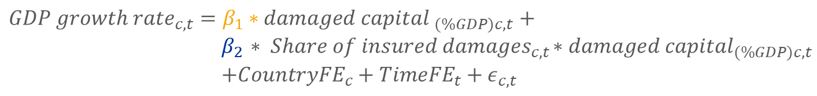
2. Empirical evidence on the macroeconomic impact of the protection gap
Abstracting from climate change, our model implies that the GDP growth rate of country c at time t is a function of damages from natural disasters and insurance
β₁ <0 damages from natural disasters negatively affect GDP growth
β₂ >0 insurance mitigates this impact
$${GDP growth rate}_{c,t}=β_{1}∗{damaged capital }_{(\%GDP)c,t}+$$
$$β_{2}{ ∗ Share of insured damages}_{c,t}{∗damaged capital}_{(\%GDP)c,t}$$
$$+{CountryFE}_{c}+{TimeFE}_{t}+ε_{c,t}$$
Notes:
The impact of past natural disasters on GDP growth and the interplay with insurance can also be tested empirically, abstracting from future climate change.

Slide 10
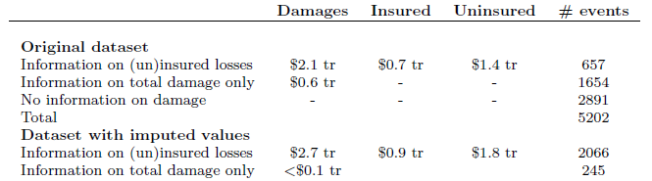
2. Empirical evidence on the macroeconomic impact of the protection gap
Dependent variable: quarterly real GDP growth rates from OECD for 45 countries
Explanatory variables: disaster data from EMDAT
Data on over 5000 disaster events since 1996, but insured only for 657 events, on average larger
  Imputation to obtain over 2000 events with insured/uninsured split
  The average disaster cost is 0.16% of GDP, while the average share of insured losses is 47%.
Sources: EM-DAT, OECD and authors’ calculations.
Notes: values in constant 2010 USD
Notes:
The impact of past natural disasters on GDP growth and the interplay with insurance can also be tested empirically, abstracting from future climate change.
The empirical model is estimated using panel data on quarterly GDP growth rates between 1996 and 2019 in 45 mostly developed countries but with some emerging market economies including Brazil, India, Russia, South Africa and Turkey. The vent types included are hydrological (e.g., floods, 38%), meteorological (e.g., storms, 31%), climatological (e.g., drought) and geophysical (e.g., earthquake).
Although geophysical disasters such as earthquakes are independent of climate change, we include them in our analysis to increase the sample size, especially in relation to very large disasters.
The dataset includes quarterly data on (i) real GDP growth rates, (ii) financial damages from natural disasters as a share of GDP (to proxy the share of damaged capital) and (iii) the share of financial damages covered by insurance (to proxy the share of insured damages). Data on insured and total damages come from EM-DAT, which is an international disasters database (link). Since data on insured damages are available for around 650 disasters, insured damages are imputed for around 1400 additional events for which total damages are available.
The insured damages are imputed based on a country-specific regression model, where the dependent variable is the share of insured losses in total damages and the explanatory variables include the log of total damage and dummies for eight different types of disaster (drought, earthquake, extreme temperature, flood, landslide, mass movement, storms, volcanic activity, wildfire) to the extent applicable for a given country. For some countries, the model cannot be estimated owing to a low number of observations, resulting in around 250 events with damage data but no imputed values for insured/uninsured losses. In the empirical results, I will present the estimates based on both the smaller sample, where insured and uninsured losses are split in the data, and the wider sample which exploits the imputed split.
The mean disaster cost in this sample is 0.16% of GDP. This number may seem low as it reflects the fact that quarterly GDP data are mainly available for developed countries, where natural disasters have typically had a smaller impact relative to GDP in the past. Indeed the disaster damage exceeds 1% of GDP for only 18 observations.
The average share of insured losses in the sample is around 47%.

Slide 11
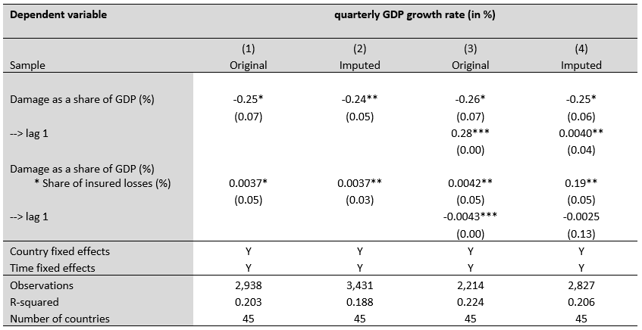
2. Empirical evidence on the macroeconomic impact of the protection gap
Sources: EM-DAT, OECD and authors’ calculations.
Notes:
Using a panel regression with standard errors clustered by country, we estimate the impact of disasters and insurance on GDP growth. Let’s start from column (1) on the sample for which insured and uninsured losses are split in the underlying dataset. The sign of the coefficients is as expected, with greater damages from disasters being associated with a lower growth rate but with this effect being mitigated by a higher share of insured losses. The statistical significance of both coefficients improves when we use the larger sample with imputed data in column (2), while the size of the coefficients remains almost unchanged.
To further investigate such potential rebound effects, we test the effect of lagged disaster damage and insurance coverage on the quarterly GDP growth rate in columns (3) to (4). The results suggest that, on average, there is a rebound in GDP growth one quarter after a disaster happens (coefficients of further lags are estimated as insignificant).
However, while reconstruction activity is recorded as positive in GDP growth numbers, in reality it does not represent a gain to welfare since it takes away available output that could otherwise be used for improving the current capital stock, or for consumption (as we explained in the theoretical model).

Slide 12
2. Empirical evidence on the macroeconomic impact of the protection gap
The higher the insurance coverage, the lower the impact of disasters on GDP growth:
Following a disaster loss of 1% of GDP, the quarterly GDP growth rate is estimated to decline by 0.25 pp in the absence of insurance coverage.
If half the losses are insured, the GDP growth rate falls by 0.06 pp.
For unusually high shares of insured losses (75%), estimates suggest an increase in GDP growth by 0.04 pp, reflecting swift reconstruction activity
Impact of natural disasters on quarterly GDP growth rate by size of damage and insured share
(x-axis: total damage as a share of GDP (in %); y-axis: simultaneous impact on quarterly GDP growth rate in percentage points)
Sources: EM-DAT, OECD and authors’ calculations.
Notes:
Here we see the magnitude of the estimated impact of disasters on GDP growth using different levels of insurance.
If a large disaster occurs, causing damages equivalent to 1% of GDP, the quarterly GDP growth rate is estimated to decline by 0.25 percentage points in the absence of insurance coverage – for instance, from the median growth rate of around 0.7% in our sample to around 0.45%. But if half the losses are insured, the GDP growth rate is only estimated to fall by around 0.06 percentage points. For unusually high shares of insured losses – e.g. a 75% insured share, which corresponds to the 90th percentile of the distribution – our model even suggests an almost immediate (within quarter) slight increase in GDP growth, which likely reflects swift reconstruction activity.

Slide 13
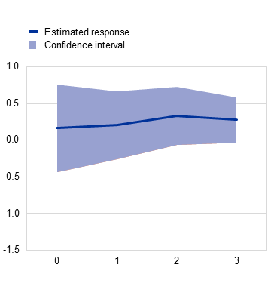
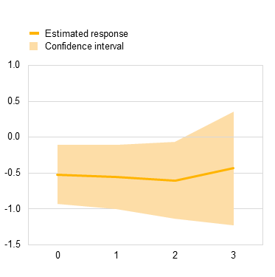
2. Empirical evidence on the macroeconomic impact of the protection gap
GDP growth rates decrease following large-scale disasters, when insurance coverage is low.
Insurance supports GDP growth after disasters, as (prompt) payouts support reconstruction.
Impact of insured vs uninsured losses from a large-scale disaster on annual GDP growth rate
(y-axis: impact on annual GDP growth rate (%); predictions up to three quarters ahead after a large-scale disaster)
High share of insured losses
Low share of insured losses
Sources: EM-DAT, OECD and authors’ calculations.
Notes:
To account for the non-linearities in the theoretical model, we estimate an alternative empirical specification using two dummy variables to capture large-scale natural disasters with high and low shares of insured losses respectively. In view of the relatively high volatility of quarterly GDP data, we use as the dependent variable the annual GDP growth rate in each quarter (calculated as the year-on-year difference in the log of GDP) and include several lags of the two dummy variables. The results presented in the right panel of this Figure confirm the adverse effect on the GDP growth rate from large-scale natural disasters when insurance coverage is low. This adverse effect is then estimated to drag on the annual GDP growth rate for up to three quarters after the disaster.
For large-scale disasters with a high share of insured losses, the GDP growth rate is estimated to be higher and does not deviate significantly from its long-term trend. This suggests that insurance supports GDP growth after disasters, likely as insurance payouts can support reconstruction.
[Chart notes: The sample includes 45 countries for which the OECD provides quarterly GDP data from 1996 to 2019. The charts show the impact of large-scale natural disasters (i.e. with total damage larger than the third quartile at 0.1% of GDP) when the share of insured losses is high (above the median of 35%) in the left panel, and low (i.e. below the median of 35%) in the right panel. The estimates are obtained using a panel regression model where the dependent variable is the year-on-year difference in the log of GDP and the explanatory variables include two dummies capturing large-scale disasters with a high and low share of insured losses respectively (included with up to three lags), and country and quarterly fixed effects. For the quarter including the date(s) of the disaster (t=0) and the three subsequent quarters, the y-axis measures the percentage point impact of the disaster on the year-on-year annual growth rate at the end of that quarter.]

Slide 14
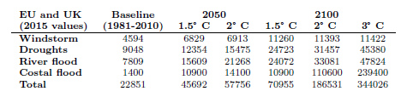
3. Impact on GDP under climate change and protection gap scenarios
Moderate and severe climate scenarios: 2 and 3-degree temperature increases by 2100
JRC PESETA IV estimates based on IPCC climate change scenario: Annual GDP losses from disasters are projected to increase by 2.5-4.5 times by the end of this century
The role of insurance protection gap
We project our empirical estimates forward to assess the future impact of natural disasters on European GDP, under different levels of insurance protection gap
Expected annual damages from climate-related catastrophes
Sources: JRC PESETA IV and authors’ calculations.
Notes: values in million EUR. Last row as share of GDP.
Notes:
We have two ingredients: the climate scenarios and the estimates on the role of the climate insurance protection gap.
We take the Representative Concentration Pathways (RCP) developed by the Intergovernmental Panel on Climate Change (IPCC) to define moderate and severe global warming scenario, respectively corresponding to 2 and 3 degree temperature increases by 2100.
The JRC calculates in the PESETA IV report the estimated annual damages and GDP losses for Europe arising from climate-related catastrophes, based on granular regional and sectoral models and assuming no adaptation or mitigation measures. We consider these JRC projected damage estimates for different types of climate-related disasters.
The table here shows the expected annual damages for key perils, and in the last row the total damages as share of GDP. Expected annual damages are estimated to increase from the baseline of 0.17% of GDP to 0.41% in 2100 under the moderate scenario and 0.76% in the severe scenario.
We combine the PESETA IV damage estimates with data from the EIOPA’s dashboard on the insurance protection gap and we generate six scenarios. We take the two potential warming paths – moderate and severe – and their associated expected annual damages. And for each paths we consider three potential degrees of insurance coverage: current, which corresponds to the share of losses that are covered today (insured share of 30%), zero insurance coverage and full coverage.

Slide 15
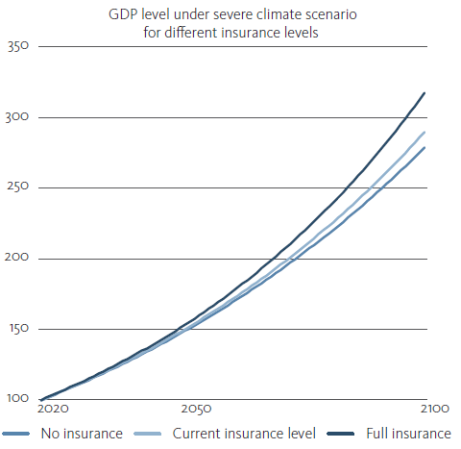
3. Impact on GDP under climate change and protection gap scenarios
Our findings
Differences in insurance coverage could have significant economic effects
By 2050, the difference between full insurance and no insurance is over 3% under the severe scenario
By the end of the century, the difference widens to around 14%
Caveats: significant uncertainty around estimates 30-80 years into the future; no adaptation or mitigation measures
Sources: JRC PESETA IV and authors’ calculations.
Notes:
Here we show the results we obtain for the severe scenario, with a 3-degree increase in temperature. In this context, we show that differences in insurance coverage could have economically material effects on GDP. The difference between the GDP level assuming full and no insurance is around 3% in 2050. By the end of this century, the difference widens to around 14%.
Naturally, the uncertainty around estimates 30-80 years into the future is substantial due to material uncertainties in the climate and economic projections. In particular, these results assume that no action would be taken to counteract the increasing risk related to climate change through mitigation or adaptation measures.

Slide 16
4. Conclusions and policy implications
Climate change has the potential to impair the stable provision of insurance services and credit → impact on households, firms, banks and sovereigns.
Data gaps on climate loss and (un)insured losses need to be closed.
Policy should aim to reduce protection gap while incentivising adaptation and risk reduction from policyholders.
Notes:
Our work is essentially arguing how climate change has the potential to impair the stable provision of (general) insurance services, thereby threatening the ability of the financial system to fulfil one of its core functions (and potentially also threatening credit provision). Notably, we show the implications of that by (i) quantifying that risk in terms of GDP and (ii) highlighting it in a theoretical model that demonstrates some of the likely welfare implications.
Financial stability implications:
Lower insurance coverage increases the impact of disasters on the real economy through direct losses to households and non-financial corporations, which can impair their consumption and production capacity
In such cases, governments – and therefore taxpayers – may also need to step in and bear the uninsured losses, with potential implications for sovereign indebtedness and the cost of government borrowing
In addition, the exposure of banks and other financial institutions to physical risk depends highly on the extent to which assets and collateral are covered by insurance. If insurance coverage decreases, this raises potential losses for financial institutions.
In many countries households cannot get a mortgage without insurance. In NZ for example, this always causes some ructions every time there’s a large earthquake as insurers stop writing new policies for a couple of weeks, and hits people in the middle of buying houses.
Vulnerability and resilience to climate change have a significant impact on the cost government borrowing. See for example the IMF Working Paper “This Changes Everything: Climate Shocks and Sovereign Bonds”.
Two-thirds of banks’ exposures to firms highly or increasingly subject to physical risks are secured by collateral, which plays an important role in mitigating losses for banks but may itself be subject to damage or loss of value.
Policy options set out in a ladder approach, designed to address the losses borne by various parties at different loss layers
First, enhancing private insurance, which remains the first and primary line of defense. This includes both traditional insurance / reinsurance but also greater use of alternative risk transfer / cat bonds – second layer on the ladder.
Then, we consider national public authorities and the role they can play, including by providing a public backstop.
And finally, we show how risks can be polled at a European level.

Slide 17
4. Conclusions and policy implications
Policy options to reduce the climate insurance protection gap
Improve private insurance solutions via impact underwriting
Enhance risk assessment, risk prevention and risk transfer to address limits of the private insurance market and provide a public backstop for more frequent hazards, e.g. via public-private partnerships and capital markets
Include a European public component, to promote adaptation and complement existing instruments
Enhance efficiency in the way public funds are used and reduce moral hazard
STAKE
HOLDERS
Primary line of defence – impact underwriting an important element

Slide 18
THANK YOU!
We welcome comments and feedback on the analysis and policy options, ideally by 15 June 2023 via email: ecb_eiopa_staff_protection_gap@eiopa.europa.eu
STAKE
HOLDERS
Notes:
The ECB and EIOPA:
welcome comments and feedback on all aspects of discussion paper, ideally by 15 June 2023 via email: ecb_eiopa_staff_protection_gap@eiopa.europa.eu;
will undertake further analysis of these policy options, taking into account comments received on discussion paper

Slide 19
Background

Slide 20
Bank-insurance nexus
Exposure of euro area banks towards high-risk firms for floods and all other hazards
(lhs: euro billions; rhs: protection gap score)
Flood risk
Other hazards
Sources: EIOPA Dashboard, Anacredit, 427 and ECB calculations.
Notes: Credit exposures to NFCs above €25,000 are considered; NFC location used to assign risk levels refers to the head office and the location of subsidiaries of the largest listed firms. Only NFCs domiciled in areas that are classified as high-risk or red flag are included. The country breakdown refers to the firm’s domicile. The total collateral value at instrument level is capped at the value of the instrument. The protection gap of firms is proxied by the protection gap score of its country.
Notes:
Physical risk mitigation for banks mainly takes place through insurance and collateralisation mechanisms. In the banking sector, more than half of loans to firms are secured by financial or real estate collateral. Hence, loans collateralization is potentially an important instrument to mitigate the impact of climate-related shocks of physical risk exposures. However, climate-related and weather events can also damage the physical collateral and result in potential losses for banks if this collateral is not fully insured. As such, insurance instruments can increase significantly system-wide resilience to shocks by mutualising and transferring losses to (re-)insurance companies, which are better equipped to manage their climate-related exposures. For this reason, the existence of a significant insurance protection gap in those EU countries with large banking sector exposures to physical risk events that are uncollateralised or secured by physical collateral is a particular source of concern.
Around 75% of the exposures of euro area banks to firms subject to high or increasing flood risk is uncollateralised or secured by physical collateral (left chart). This raises concerns especially in countries where there is also a high insurance protection gap for floods, such as Germany and Italy. The potential loss of value for banks exposed to high-risk firms would be significant, should extreme floods intensify or hit a large part of these firms, and may result in a lower provision of credit, with consequences for high-risk and lower income borrowers and the wider macroeconomy. The exposure of euro area banks to firms subject to other hazards is much lower, but it is also mostly uncollateralised or secured by physical collateral (right chart).

Slide 21
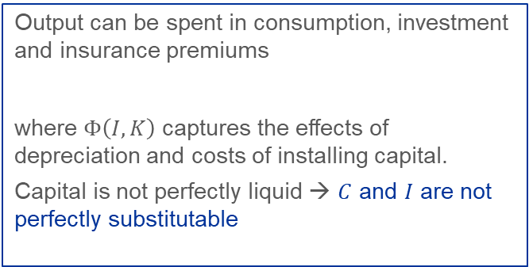
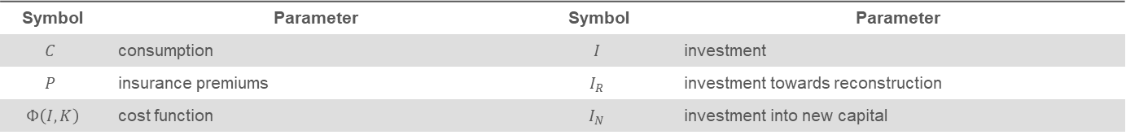
Impact of natural disasters on capital
Output can be spent in consumption, investment and insurance premiums
where $Φ\left(I,K\right)$ captures the effects of depreciation and costs of installing capital.
Capital is not perfectly liquid → $C$ and $I$ are not perfectly substitutable
There are two types of investments
The marginal return on reconstruction is higher than the marginal return on new capital
After disasters, investment is first devoted to replacing the destroyed capital.
But there may be financial, technical and institutional constraints
$$I=I_{R}+I_{N}$$
$$Y=C+\left(I+Φ\right)+P$$
Symbol | Parameter | Symbol | Parameter
$$C$$ | consumption | $$I$$ | investment
$$P$$ | insurance premiums | $$I_{R}$$ | investment towards reconstruction
$Φ\left(I,K\right)$ | cost function | $$I_{N}$$ | investment into new capital
Notes:
In each period, aggregate output can be spent in consumption C, investment I and insurance premiums P.
In the presence of adjustment costs, the capital is not perfectly liquid and cannot be used for consumption without incurring some costs, i.e. consumption and investment are not perfectly substitutable.
After a disaster, damaged assets are replaced or repaired by reducing consumption and regular investment. We define two types of investments: investment towards reconstruction of the damaged capital, IR, that increases the residual capital remaining after disasters, and investment into new capital, IN, that would regularly increase the production capacity K (i.e. independent of disasters).
Consistent with empirical evidence, the marginal return on reconstruction is higher than the marginal return on new capital: e.g. following disasters, the construction of new buildings and infrastructure would be postponed to rebuild the damaged ones. Therefore, when capital is destroyed in a catastrophe, investment is first devoted to replacing the destroyed capital.
The time it takes to rebuild destroyed capital depends not only on the extent of the losses, but also on the cost and availability of financial tools for households and firms (Hallegatte et al., 2007). In practice, the pace of reconstruction, IR, can be limited by a lack of savings or borrowing capacity, for example, or by limited production capacity in certain sectors, such as construction. This leads to consumption losses since C would be reduced in favor of I and reconstruction periods would be much longer than what the initial amount of damage would suggest.
Insurance can relax these financial constraints by quickly repaying insured damages and reducing consumption losses.
[So in practice, IR is bounded in our model by the fraction of total investment that can be mobilised.]

Slide 22




Impact of natural disasters on capital
In a standard macroeconomic model, the (replacement) value of an asset is equal to its future output.
Losing €1 in asset is equivalent to losing €1 in (discounted) output.
Production
A
$$Y_{0}$$
$$Y_{1}$$
B
This is valid only if capital can be freely and instantaneously reallocated
$$K_{0}$$
Capital
$$K_{0}−ΔK$$
See Hallegatte and Vogt-Schilb, 2019
Notes:
In a standard macroeconomic model, the (replacement) value of an asset is equal to its future output. So losing €1 in asset is equivalent to losing €1 in (discounted) output.
BUT this is valid only if capital can be freely and instantaneously reallocated

Slide 23

Impact of natural disasters on capital
Without reallocation and reconstruction, the impact of a disaster is the sum of:
  a reduction in the stock of capital (drop in K): Y₀ to Y₁
  a misallocation of the residual stock compared to optimal (drop in TFP): Y₁ to Y₂
Over the short run, losing €1 in asset is equivalent to losing €2 in (discounted) output
Production
A
$$Y_{0}$$
$$Y_{1}$$
B
$$Y_{2}$$
B’
Reconstruction has a higher marginal returns than other investments
$$K_{0}$$
Capital
$$K_{0}−ΔK$$
See Hallegatte and Vogt-Schilb, 2019
Notes:
In reality, different infrastructure assets have different impacts on various economic sectors. Imagine a bridge that gets damaged, and factories cannot produce for some time. Then the impact on production is larger than the value of the lost assets.
If disaster damages all assets proportionally and there is no reallocation and no reconstruction, then the impact of a disaster is the sum of a reduction in the stock of capital and a misallocation of the residual stock compared to optimal, which results in a drop in total factor productivity.
So over the short run losing €1 in asset is equivalent to losing €2 in (discounted) output (use Average Productivity of capital – APK, instead of Marginal Productivity of capital – MPK).
Therefore, reconstruction is always a priority over “normal” investments, consistent with empirical studies (Bakkensen and Barrage, 2020; Dieppe, Celik, and Okou, 2020)

Slide 24
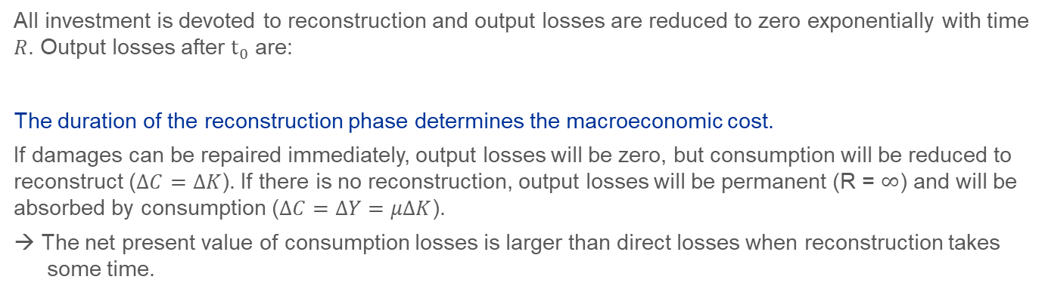

Impact of natural disasters on capital
All investment is devoted to reconstruction and output losses are reduced to zero exponentially with time $R$. Output losses after $t_{0}$ are:
The duration of the reconstruction phase determines the macroeconomic cost.
If damages can be repaired immediately, output losses will be zero, but consumption will be reduced to reconstruct ($ΔC=ΔK$). If there is no reconstruction, output losses will be permanent (R = $∞$) and will be absorbed by consumption ($ΔC=ΔY=μΔK$).
→ The net present value of consumption losses is larger than direct losses when reconstruction takes some time.
$$ΔY\left(t\right)=μΔKe^{−(t−t_{0})/R}$$
Symbol | Parameter | Symbol | Parameter
$$R$$ | time of reconstruction | $$μ$$ | average productivity of capital, $Y/K$
Notes:
We assume that all investment is devoted to reconstruction because of the higher return of IR with respect to IN, and that output losses are reduced to zero exponentially with a characteristic time of reconstruction R.
This implies that the economy returns to its pre-disaster state, although in practice some activities could be permanently destroyed.
The duration of the reconstruction phase therefore determines the macroeconomic cost of natural disasters. If damages can be repaired immediately, output losses will be zero, but consumption will be reduced to reconstruct (i.e. C = K). By contrast, if there is no reconstruction, output losses will be permanent (R = infinite) and will be absorbed by consumption.
Assuming that the productivity of destroyed capital is equal to the average pre-disaster productivity of capital, the model therefore implies that the net present value of consumption losses is larger than direct losses when reconstruction takes some time. In other words, consumption and welfare losses are magnified when reconstruction is delayed or slowed down.
In a standard macroeconomic model, the total consumption loss does not depend on the duration of the reconstruction period. But with non-marginal impacts, the duration of the reconstruction period becomes essential and drive the impact on consumption

Slide 25
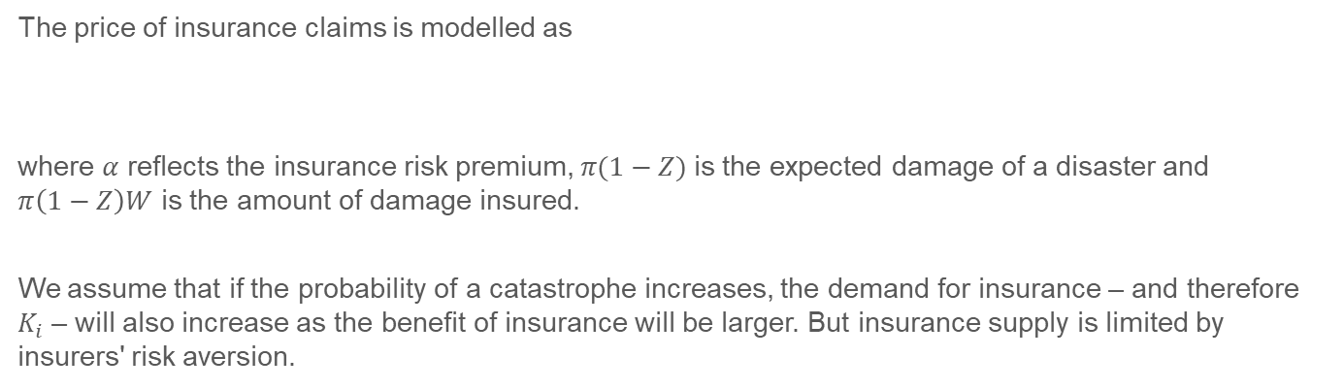


Impact of natural disasters on capital
The price of insurance claims is modelled as
where $α$ reflects the insurance risk premium, $π(1−Z)$is the expected damage of a disaster and $π\left(1−Z\right)W$ is the amount of damage insured.
We assume that if the probability of a catastrophe increases, the demand for insurance – and therefore $K_{i}$ – will also increase as the benefit of insurance will be larger. But insurance supply is limited by insurers' risk aversion.
$$p\left(W,Z\right)=απ\left(1−Z\right)W$$
Symbol | Parameter
$$α$$ | insurance risk premium
Notes:
The price of insurance claims is modelled as… where alpha reflects the insurance risk premium and depends on the risk aversion of insurance, ….
Should the shock arrive, the policyholder would receive a lump-sum payoff of one unit of consumption. If the disaster probability (arrival rate) increases, the insurance premium would increase too, as insurers will pay more claims. At the same time, for a given Z, the insured share W would decrease. This allows us to model the insurance cost endogenously.
The higher is alpha and the bigger the loss, the higher the insurance premium, as the ability of insurers to diversify their portfolio and pool risks together decreases. The literature suggests that risk aversion among insurance capital providers can increase the value the insurance risk premium, for example after major natural disasters.
We assume that if the probability of a catastrophe, , increases, the demand for insurance Ki will also increase as the benefit of insurance will be larger other things being equal. But insurance supply is limited by insurers' risk aversion.
[The insurance protection gap can widen for several reasons that relate both to insurance supply and demand. Insurers' risk aversion typically increases after large natural disasters. Also, a lack of awareness or willingness to buy insurance cover even when it is affordable and accessible, is not uncommon in many developed countries.
But the protection gap may also widen from the rising price or the unavailability of certain types of insurance coverage, especially due to risk factors related to climate change. If the frequency or severity of disasters rises globally, this may increase the insurance risk premium and reduce its risk pooling benefit. In this situation, buyers are aware and willing to buy insurance cover but are unable to do so due to unaffordability or insufficient availability.]

Slide 26
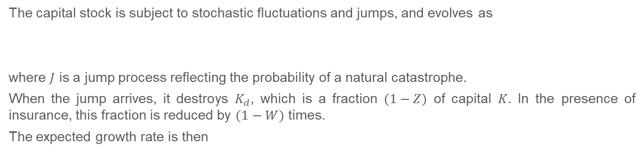
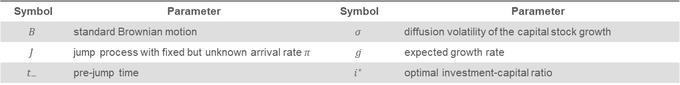
Impact of natural disasters on capital
The capital stock is subject to stochastic fluctuations and jumps, and evolves as
where $J$ is a jump process reflecting the probability of a natural catastrophe.
When the jump arrives, it destroys $K_{d}$, which is a fraction $(1−Z)$ of capital $K$. In the presence of insurance, this fraction is reduced by $(1−W)$ times.
The expected growth rate is then
$$dK_{t}=Φ \left(I_{t−},K_{t−}\right)dt +σK_{t−}dB_{t}−(1−W)(1−Z)K_{t−}dJ_{t}$$
$$\overline{g}=φ\left(i^{∗}\right)dt −π E(1−W)(1−Z)$$
Symbol | Parameter | Symbol | Parameter
$$B$$ | standard Brownian motion | $$σ$$ | diffusion volatility of the capital stock growth
$$J$$ | jump process with fixed but unknown arrival rate $π$ | $$\overline{g}$$ | expected growth rate
$$t_{−}$$ | pre-jump time | $$i^{∗}$$ | optimal investment-capital ratio
Notes:
The first term is investment, adjusted for depreciation and costs of installing capital. The second term captures continuous shocks to capital that are standard in macroeconomic models, where Bt is a standard Brownian motion and the parameter signa is the diffusion volatility of the capital stock growth. t- denotes the pre-jump time. The third term represents the effect of disasters.
J is a jump process reflecting the probability of a natural catastrophe with a fixed but unknown arrival rate, $π$. When the jump arrives, it destroys Kd, which is a fraction (1 – Z) of capital K. The novelty of our model is that in the presence of insurance, this fraction is reduced by $(1−W)$times.
The expected growth rate is denoted by g bar. The second term is the expected percentage decline of the capital stock due to catastrophes. While insurance may crowd out investment, it enhances long-run growth by reducing the expected loss due to catastrophes $E(1−W)(1−Z)$.

